Slide 1
Given a container that writes a log file in format A and a container that converts logs files form fromatA to foramtB, create a deployment that runs both containers such that the log files from the first container are converted by the second container, emitting logs in formatB.
- Create a deployment named deployment-007 in default namespace, that- includes image busybox:1.28 container, named web-one
- Includes a sidecar busybox:1.28 container, named sidecar-two
- Mounts a share volume /tmp/log on both containers, which does not persist when the pod is deleted.
- Instruct the web-one container to run the command
---
while true; do
echo "i luv cncf" >> /tmp/log/input.log;
sleep 10;
done
which should output logs to /tmp/log/input.log in plain text format with example values.
Solution: Google--> Kubernetes.io --> Search --> side car --> Logging Architecture

Slide 2
[root@master1 ~]# kubectl create deployment deployment-007 --image=busybox:1.28 -o yaml --dry-run=client
apiVersion: apps/v1
kind: Deployment
metadata:
creationTimestamp: null
labels:
app: deployment-007
name: deployment-007
spec:
replicas: 1
selector:
matchLabels:
app: deployment-007
strategy: {}
template:
metadata:
creationTimestamp: null
labels:
app: deployment-007
spec:
containers:
- image: busybox:1.28
name: busybox
resources: {}
status: {}
[root@master1 ~]#

Slide 3
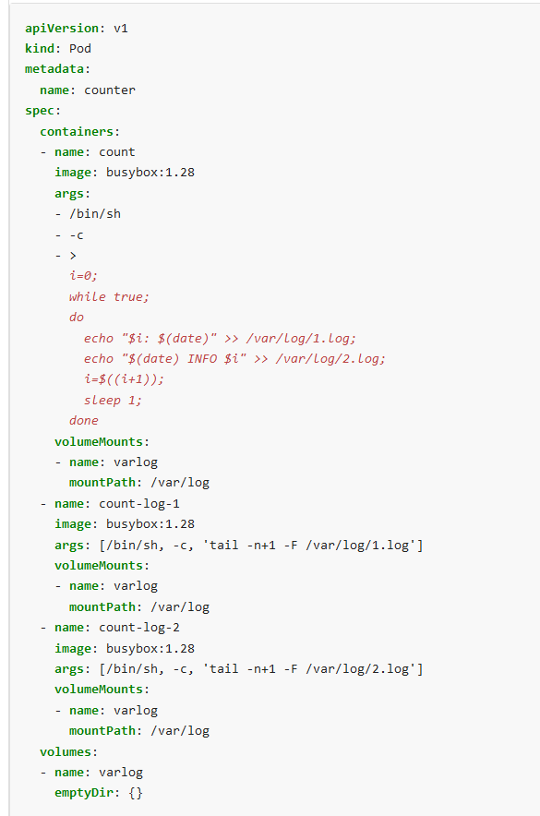
apiVersion: apps/v1 kind: Deployment metadata: creationTimestamp: null labels: app: deployment-007 name: deployment-007 spec: replicas: 1 selector: matchLabels: app: deployment-007 strategy: {} template: metadata: creationTimestamp: null labels: app: deployment-007 spec: containers: - image: busybox:1.28 name: web-one resources: {} args: [/bin/sh, -c, 'while true; do echo "i luv cncf" >> /tmp/log/input.log; sleep 10; done'] volumeMounts: - name: varlog mountPath: /tmp/log - image: busybox:1.28 name: sidecar-two resources: {} args: [/bin/sh, -c, 'tail -n+1 -F /tmp/log/input.log'] volumeMounts: - name: varlog mountPath: /tmp/log volumes: - name: varlog emptyDir: {}

